Slide 1


GTI (POL)
DBMS Project
Prepared by group3

Slide 2




Team Members
.Ma Shoon Lae Wai
Ma Yoon Darli Win Maung.
.Ma Shar Thet Han
Ma Khain Htike Htar Oo.
.Ma Aye Nyein Phyo
Mg Htet Yan Aung.

Slide 3
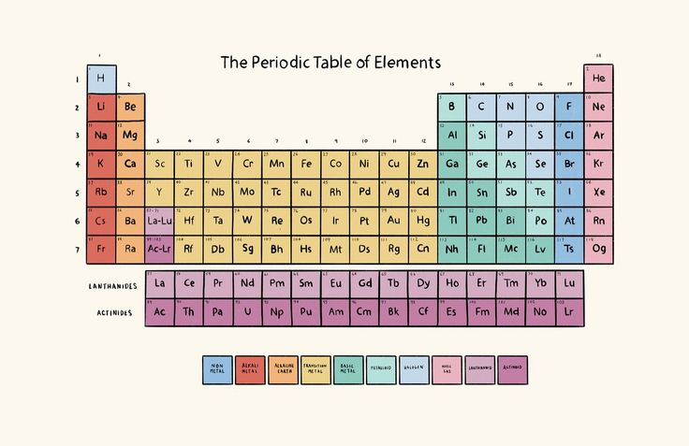
Periodic Table
ffffffffffffffffffon.

Slide 4
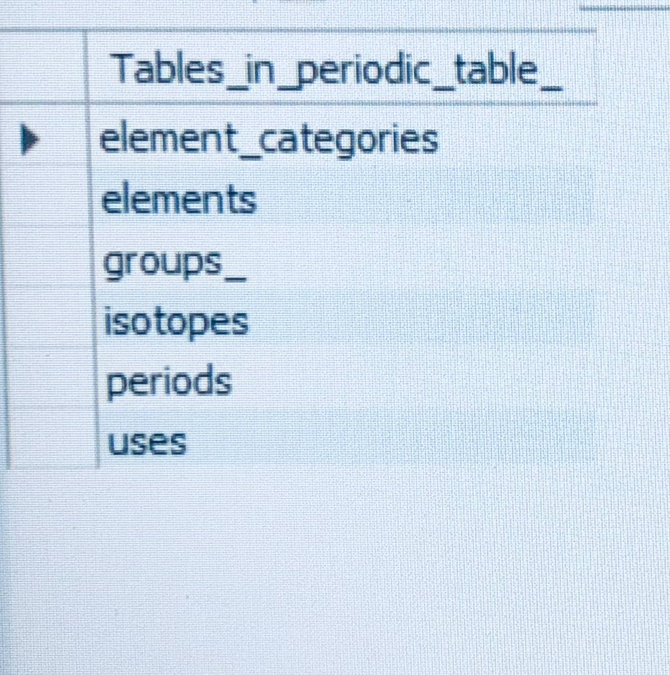
Tables
ggggggggggggggggggg

Slide 5
Element table structure
Columns
Data Type
Constrains/Description
element_id
-name
-symbol
-atomic_number
-atomic_mass
-period
-group_id
-block
-electron_configuration
-state_at_stp
-melting_point_k
-boiling_point_k
-density_g_cm3
-electronegativity
-ionization_energy_kj_mol
-electron_affinity_kj_mol
-description
-category_id
INT
VARCHAR(50)
VARCHAR(3)
INT
DECIMAL(10, 5)
INT
INT
VARCHAR(1)
VARCHAR(255)
VARCHAR(20)
DECIMAL(8, 2)
DECIMAL(8, 2)
DECIMAL(8, 4)
DECIMAL(4, 2)
DECIMAL(8, 2)
DECIMAL(8, 2)
TEXT
INT
AUTO_INCREMENT PRIMARY KEY
UNIQUE NOT NULL
UNIQUE NOT NULL
UNIQUE NOT NULL
NOT NULL
NOT NULL
(none)
(none)
(none)
(none)
(none)
(none)
(none)
(none)
(none)
(none)
(none)
FOREIGN KEY (category_id) REFERENCES element_categories(category_id)

Slide 6
Insert data in element table
INSERT INTO elements (
name, symbol, atomic_number, atomic_mass, period, group_id, block,
electron_configuration, state_at_stp, melting_point_k, boiling_point_k,
density_g_cm3, electronegativity, ionization_energy_kj_mol,
electron_affinity_kj_mol, description, category_id
) VALUES
(
'Hydrogen', 'H', 1, 1.00784, 1, 1, 's',
'1s1', 'gas', 13.99, 20.27,
0.00008988, 2.20, 1312.00,
72.8, 'Lightest element, essential in water and organic compounds.', 1
);

Slide 7
Insert data in all tables
Isotopes table
Element caregories table
INSERT INTO Isotopes (element_id, mass_number, symbol, natural_abundance, half_life_days, decay_mode, is_radioactive) VALUES
INSERT INTO element_categories (category_name, category_description) VALUES('Alkali Metal', 'Very reactive metals that readily lose their outermost electron.'),('Alkaline Earth Metal', 'Reactive metals, commonly found in the Earth''s crust.'),
Group table
INSERT INTO Groups_ (group_id, group_name, description) VALUES(1, 'Alkali Metals', 'Highly reactive metals with one valence electron. Form +1 ions.'),
Period table
INSERT INTO Periods (period_id, period_name, description) VALUES(1, 'Period 1', 'Contains hydrogen and helium. Only 2 elements.'),(2, 'Period 2', 'Contains elements from lithium to neon. 8 elements.'),
Uses table
INSERT INTO Uses (element_id, application, details) VALUES-- Hydrogen (element_id = 1)(1, 'Fuel', 'Used as rocket fuel and in fuel cells.'),

Slide 8
Sample queries
-- Noble gas
SELECT e.name, e.symbol, ec.category_nameFROM elements eJOIN element_categories ec ON e.category_id = ec.category_idWHERE ec.category_name = 'Noble Gas';
>SELECT * FROM elements ;
>select * from element_categories;
>select * from periods;
>select * from isotopes;
>select * from uses;

Slide 9
Samples
-- Atomic
NumberSELECT name, symbol, atomic_number, state_at_stpFROM elementsWHERE atomic_number <= 50 AND state_at_stp = 'Solid'ORDER BY atomic_number;

Slide 10
-- join opreationselect
-- ordering&limiting
.name,elements.symbol,element_categories.category_namefrom elements join element_categories on elements.group_id= element_categories.category_id;
select name,symbol, atomic_number from elements order by atomic_number asc;

Slide 11
Conclusion

Slide 12
Thank you
/From group 3

Slide 13
Question
&
Answer

